Slide 1
COME TO OUR BOOK FAIR
AND EARN FREE BOOKS FOR YOUR SCHOOL*
Hundreds of books from only €3.60
*Free books are subject to terms and conditions. Please contact your Book Fair Organiser or Scholastic Book Fairs for details.

Slide 2
Primary Schools Ireland – Book Range

Slide 3
Top Titles

Slide 4
Books for only €3.60
plus look out for our Tom Gates competition!

Slide 5
Our Favourites
with FREE minifigure

Slide 6
Popular Authors
plus look out for our Tom Gates competition!

Slide 7
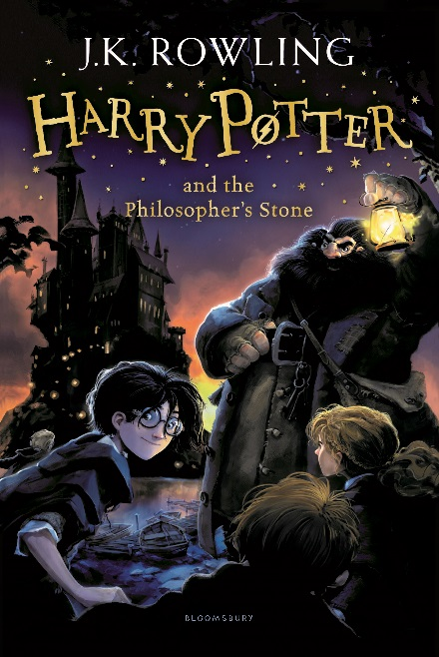
Harry Potter

Slide 8
Pocket Money Picks
€2.40 off these books with your money-off coupons

Slide 9
HAVE A GREAT BOOK FAIR
For more books visit www.bookfairs.scholastic.ie/books

